Slide 1

A gamified introduction to Python Programming Lecture 11 The art of Testing and Debugging
Matthieu DE MARI – Singapore University of Technology and Design

Slide 2

Outline (Chapter 11)
What is testing in programming?
What is a unit test?
What is the assert keyword? How is it related to error messages?
What is therefore the right philosophy for programming and testing?
What is an integration test?
What is debugging?
What are good practices in debugging?

Slide 3

Testing: a definition?
“Program testing can be used to show the presence of bugs, but never to show their absence!” – Edsger W. Dijkstra

Slide 4
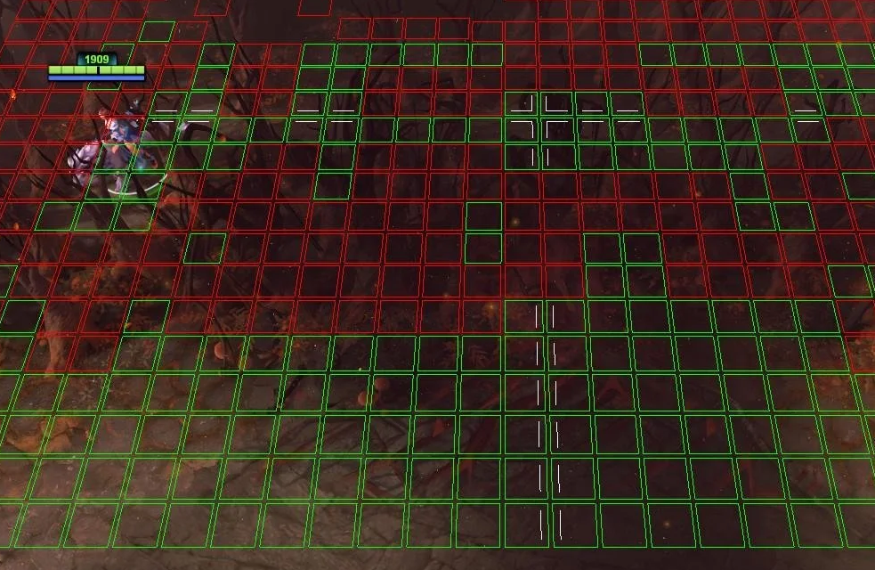
Testing: a definition?
“Program testing can be used to show the presence of bugs, but never to show their absence!” – Edsger W. Dijkstra
FYI: Dijkstra is famous for his algorithm, used for path-finding in many applications (GPS, video games, etc.)

Slide 5
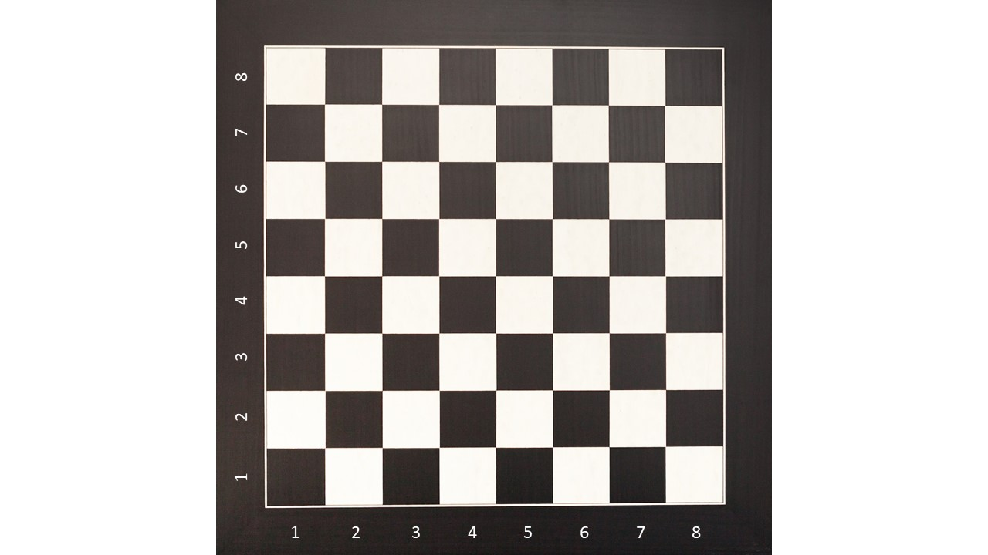
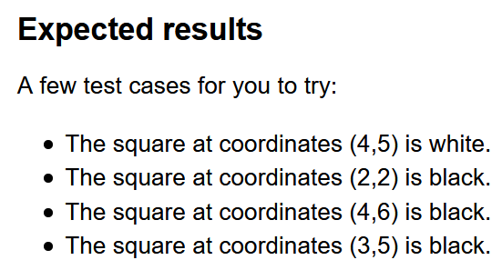
Testing: a definition?
Program testing is the process of executing a program, with the objective of finding errors.
Program testing cannot show the absence of errors. It can only show if errors are present.
Test driven development: It is often preferable to identify and write the tests before coding the program. This is something I have done for you on early activities, your job now!

Slide 6
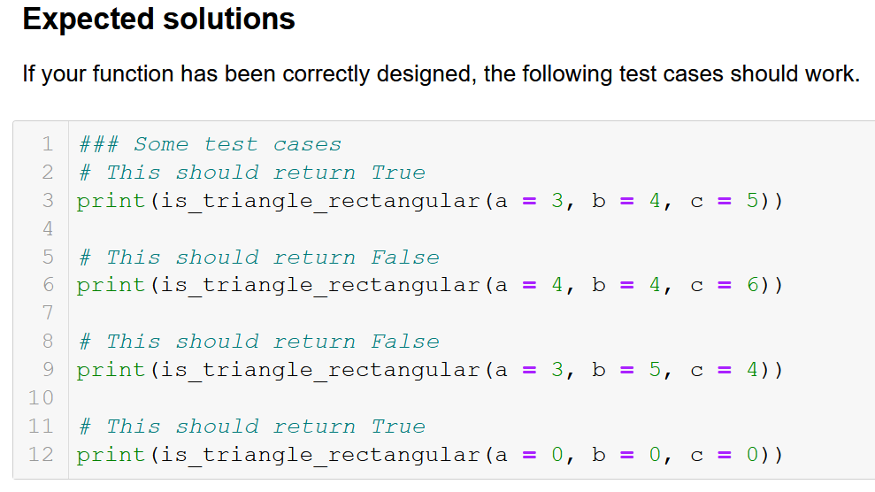
Limits of testing
Issue #1: Program testing cannot show the absence of errors. It can only show if errors are present.
Issue #2: In the ideal world, all possible paths through a programs should be tested.
But it is often impossible.
E.g., I can test all squares of an 8x8 grid, because there is a finite number of them.
But I cannot test all possible integers, lists of integers, etc.

Slide 7
Unit testing
Definition (Unit testing): Unit tests are test cases, whose objective is to verify that a single function is able to operate as expected, on a specifically identified use case.
Often a good idea to start simple, and progressively look for more complex/special cases.
Let us demonstrate on the next slides.

Slide 8
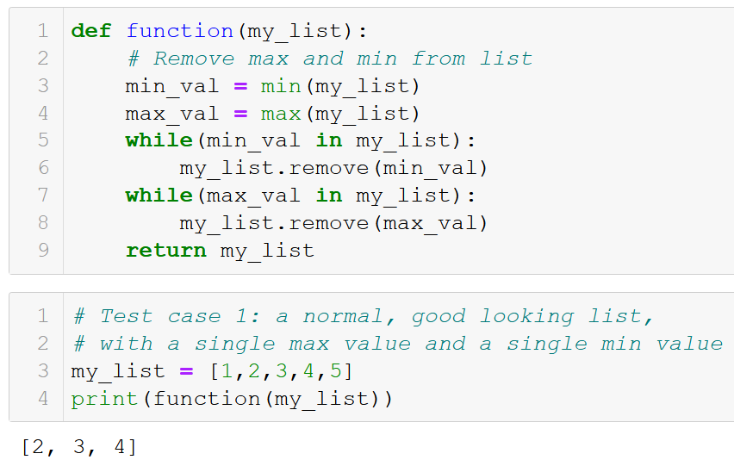

Slide 9
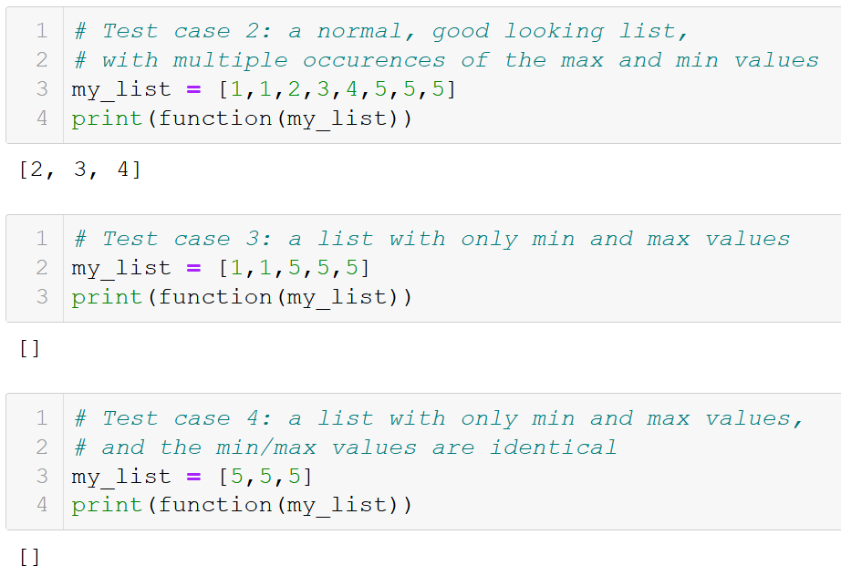

Slide 10
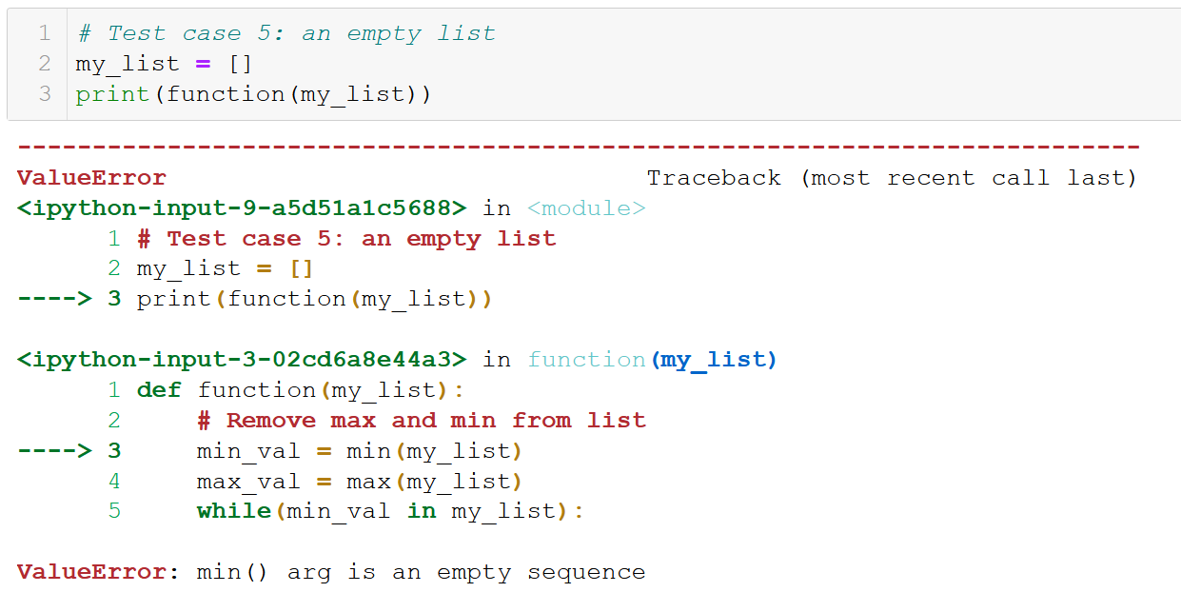

Slide 11
Unit testing
Definition (Unit testing): Unit tests are test cases, whose objective is to verify that a single function is able to operate as expected, on a specifically identified use case.
Often a good idea to start simple, and progressively look for more complex/special cases.
Let us demonstrate on the next slides.
Whenever a test case is identified as not working, amend the function to cover for this special case if needed.

Slide 12
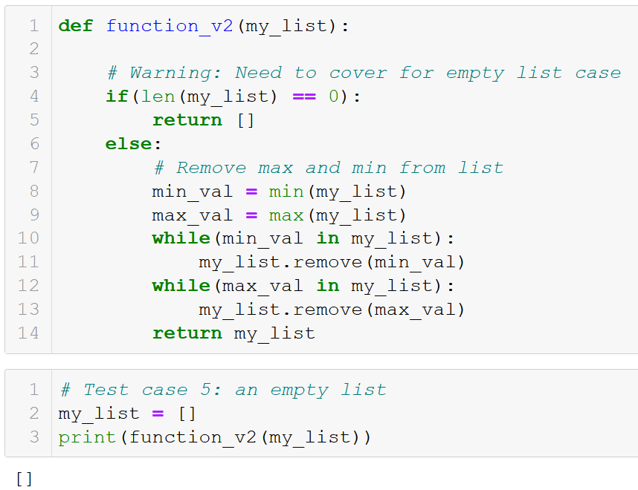

Slide 13
Unit testing
Definition (Unit testing): Unit tests are test cases, whose objective is to verify that a single function is able to operate as expected, on a specifically identified use case.
Often a good idea to start simple, and progressively look for more complex/special cases.
Let us demonstrate on the next slides.
Whenever a test case is identified as not working, amend the function to cover for this special case if needed.
Unit testing is a cat-and-mouse game!

Slide 14
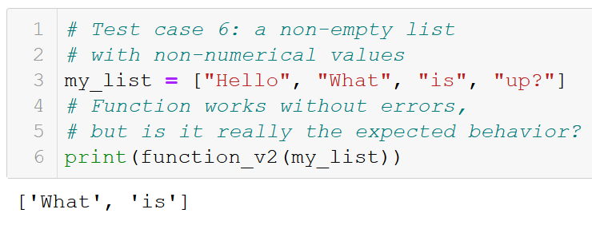
Unit testing is essential…
But ultimately, unit testing is never enough.
It is a never-ending task, as it will never be able to cover for all possible ways to break our function.

Slide 15
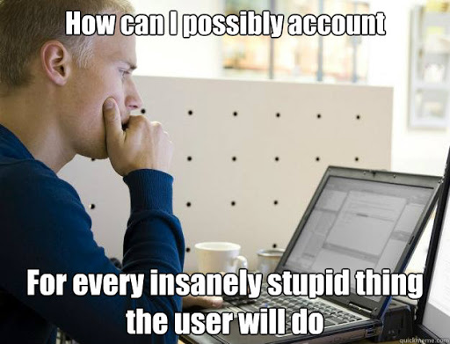
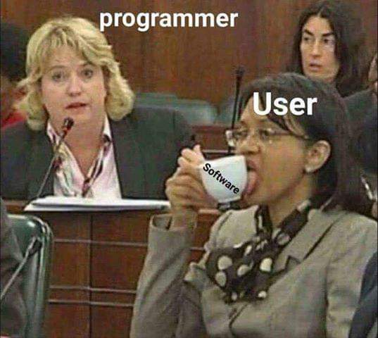
Finding the right balance?

Slide 16
Assertion testing
In some (stupid) cases, the function should simply refuse to operate.
It would sometimes be preferable if our function could check that it is indeed being used in an “acceptable” or “normal” setting.
When not, it should raise error messages to inform the user that he/she is misusing the function, if so.
That is something easily done with the assert keyword.

Slide 17
The assert Keyword
Definition (the assert keyword): The assert keyword is used for assertion testing. It is the most basic error control structure, whose objective is to verify that a function/program is being used in its intended purpose/configuration.
It receives a Boolean and a message in string format.
If the Boolean is True, nothing happens.
If False, the program crashes on purpose and the message is displayed as an error.

Slide 18
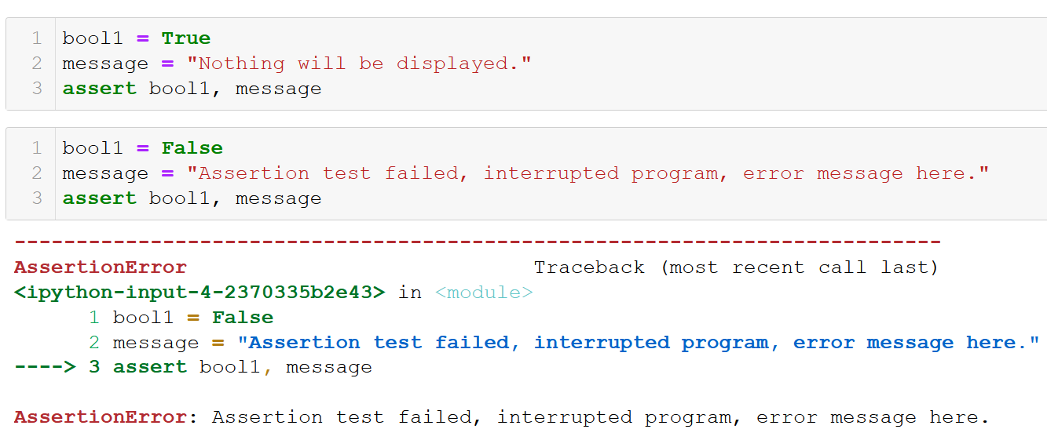
The assert Keyword

Slide 19
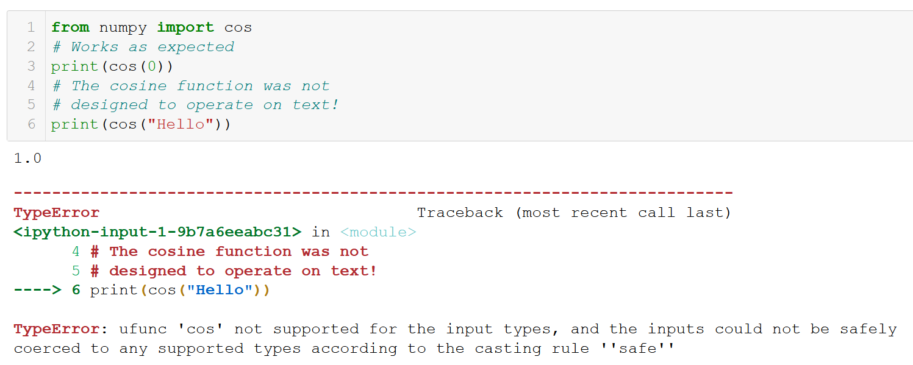
Assertions
In some (stupid) cases, the function should simply refuse to operate.
Instead, it should check that the function is indeed being used in its “normal” setting.
And raise error messages to inform the user that he/she is misusing this function, if so.
That is called assertion testing.

Slide 20
The assert Keyword
Definition (the assert keyword): The assert keyword is used for assertion testing. It is the most basic error control structure, whose objective is to verify that a function/program is being used in its intended purpose/configuration.
Typically, assert can be used to check
That a user entered digits only, when prompted with input(),
Mathematical functions are used with numerical types variables,
Etc.

Slide 21
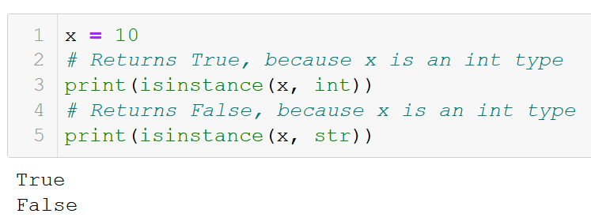
Asserting on types
Definition (type checking): Another interesting function is the isinstance() one, which is used for type checking.
It receives two arguments.
The first one is a variable,
The second a type (int, float, str, list, etc.)
It returns True, if the variable is of said type and False otherwise.

Slide 22
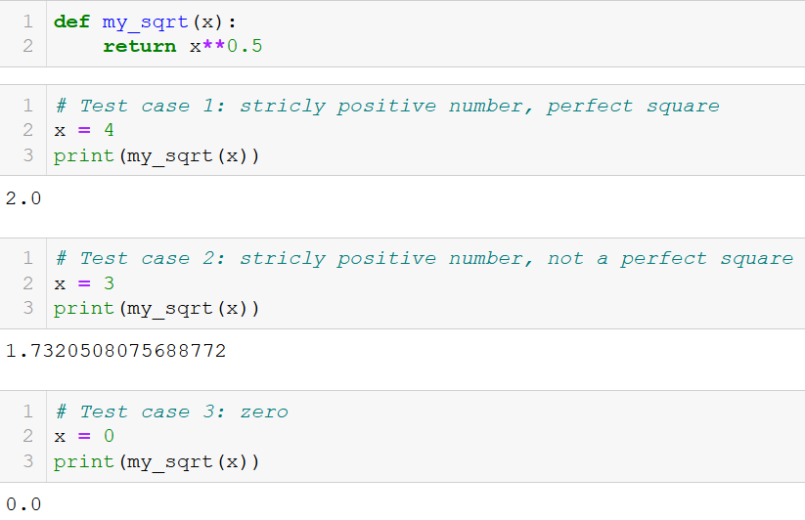
An application example: our sqrt function

Slide 23
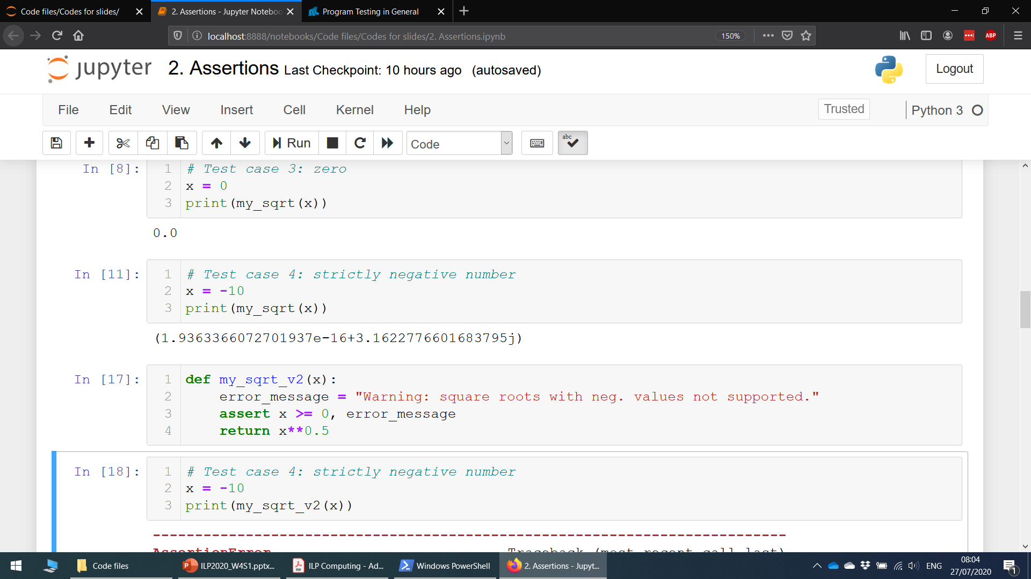
An application example: our sqrt function

Slide 24
An application example: our sqrt function

Slide 25
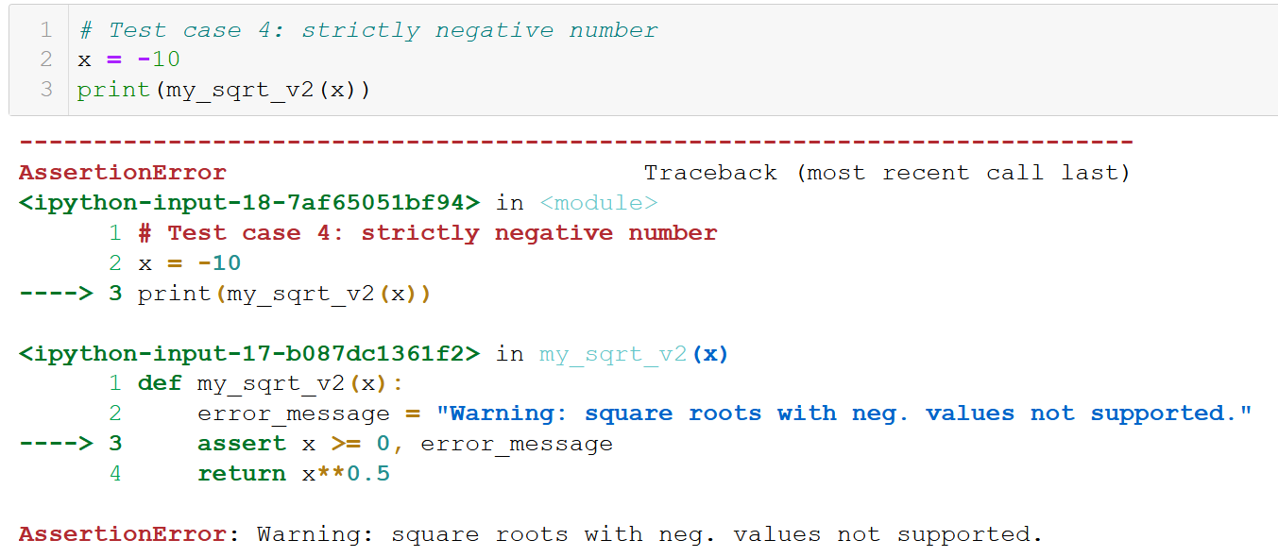
An application example: our sqrt function

Slide 26
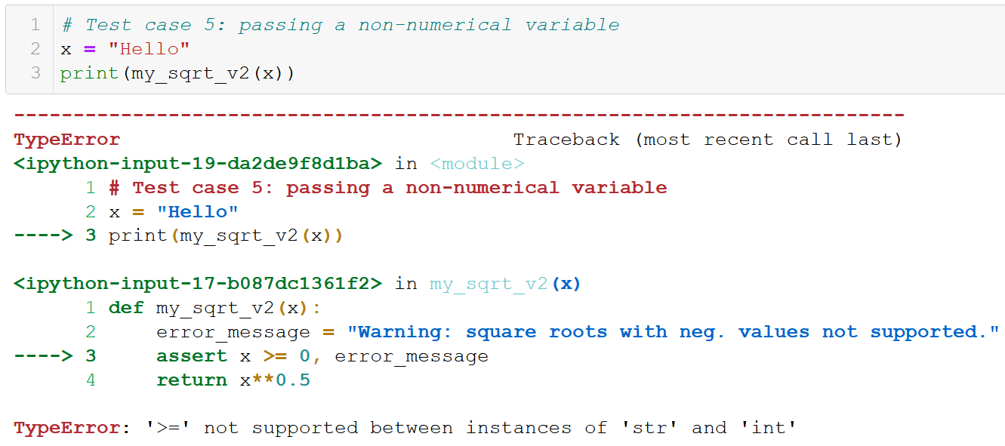
An application example: our sqrt function

Slide 27
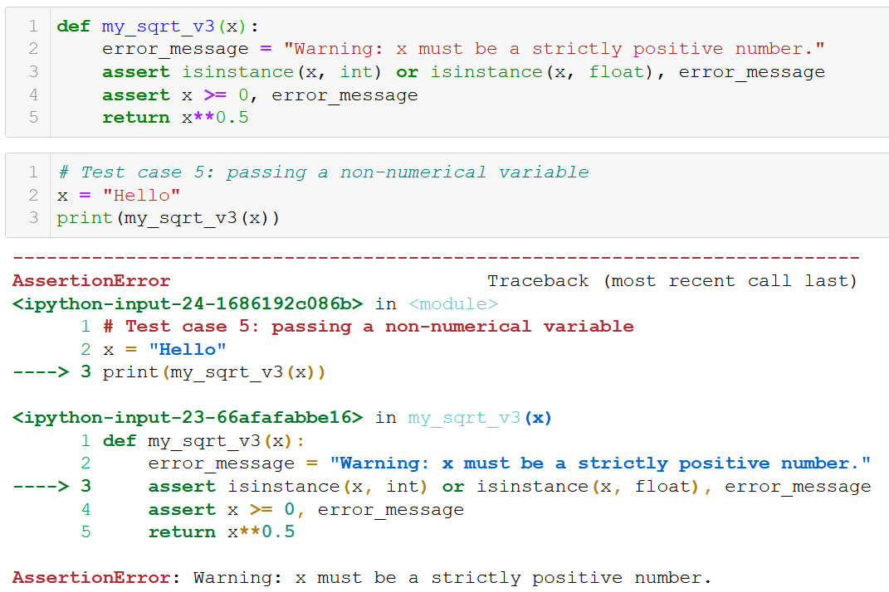
An application example: our sqrt function

Slide 28
What makes a good function?
Definition (what makes a good function):
We can define a good function as
A function that is able to operate on any of its “normal” test cases (strictly positive numbers for sqrt)
A function that is able to cover for special cases (empty lists, division by zero, etc.)
A function that raises explicative errors, if it is misused by the user (wrong variable type, not implemented feature, etc.)
(A function that produces results as fast as possible)

Slide 29
What makes a good function?
Definition (what makes a good function):
We can define a good function as
A function that is able to operate on any of its “normal” test cases (strictly positive numbers for sqrt)
A function that is able to cover for special cases (empty lists, division by zero, etc.)
A function that raises explicative errors, if it is misused by the user (wrong variable type, not implemented feature, etc.)
(A function that produces results as fast as possible)
→ Start small, progressively build up the function with more features!

Slide 30
From unit testing to integration testing
It is considered good practice to perform unit tests on ALL the functions you design, to control that they operate as expected.
It is also essential to perform integration testing.
Definition (integration testing): Integration testing focuses on testing that several subfunctions are able to operate correctly when assembled together in a larger program.
Especially important when “patching” a function: slightly modifying a single function should not make the rest of the program (game, app, etc.) malfunction!

Slide 31
From unit testing to integration testing
It is considered good practice to perform unit tests on ALL the functions you design, to control that they operate as expected.
It is also essential to perform integration testing.
Definition (integration testing): Integration testing focuses on testing that several subfunctions are able to operate correctly when assembled together in a larger program.
Especially important when “patching” a function: slightly modifying a single function should not make the rest of the program (game, app, etc.) malfunction!
MORE ON THIS TO BE COVERED IN ADVANCED CLASSES IN SUTD!

Slide 32
Error messages
Definition (what is an error message anyway?):
Error messages are exceptions, which were caught by the Python compiler program, when it attempted to execute your code.
Typically, they are assertions, which did not pass, so that the program could execute normally.
They usually consist of an approximate location of where the error occurred in your code,
And a standardized error message, attempting to explain the type of error encountered.

Slide 33
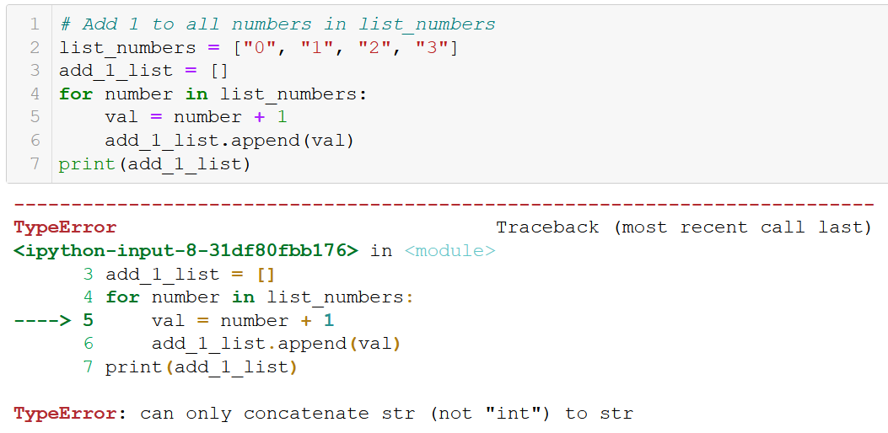
Error messages

Slide 34
Error messages

Slide 35
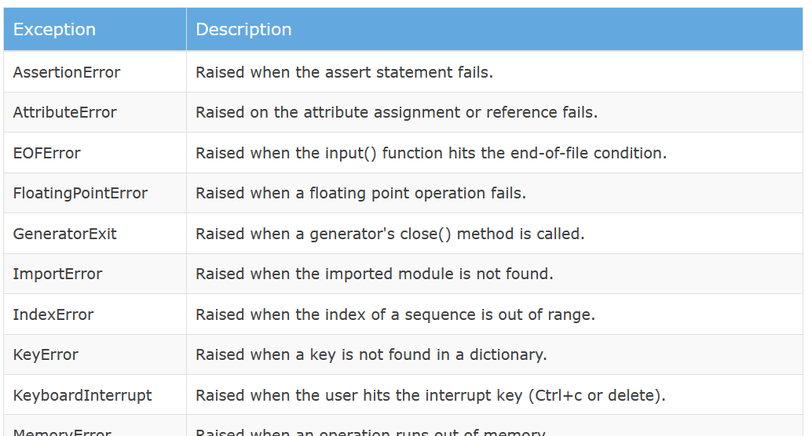
Typical error types
Learn more: https://www.tutorialsteacher.com/python/error-types-in-python

Slide 36
Debugging
Definition (Debugging): Debugging is the art/process of detecting and removing existing and potential errors (also called as 'bugs') in a code that can cause it to behave unexpectedly or crash.
To debug a program, the developer (you) has to
start with a problematic piece of code,
isolate the source of the problem,
and then propose a fix for it.

Slide 37
Debugging: Isolating a problem
How to isolate the problem
Python will try its best to provide a location of where the error occurred in its error message.
Unfortunately, it is not always good info.
It is often a good idea to try and pinpoint the location of the error, with some prints, to control which parts of the program work fine and which do not.
Feel free to comment/uncomment parts of the code to see if it affects the apparition of said error as well!

Slide 38
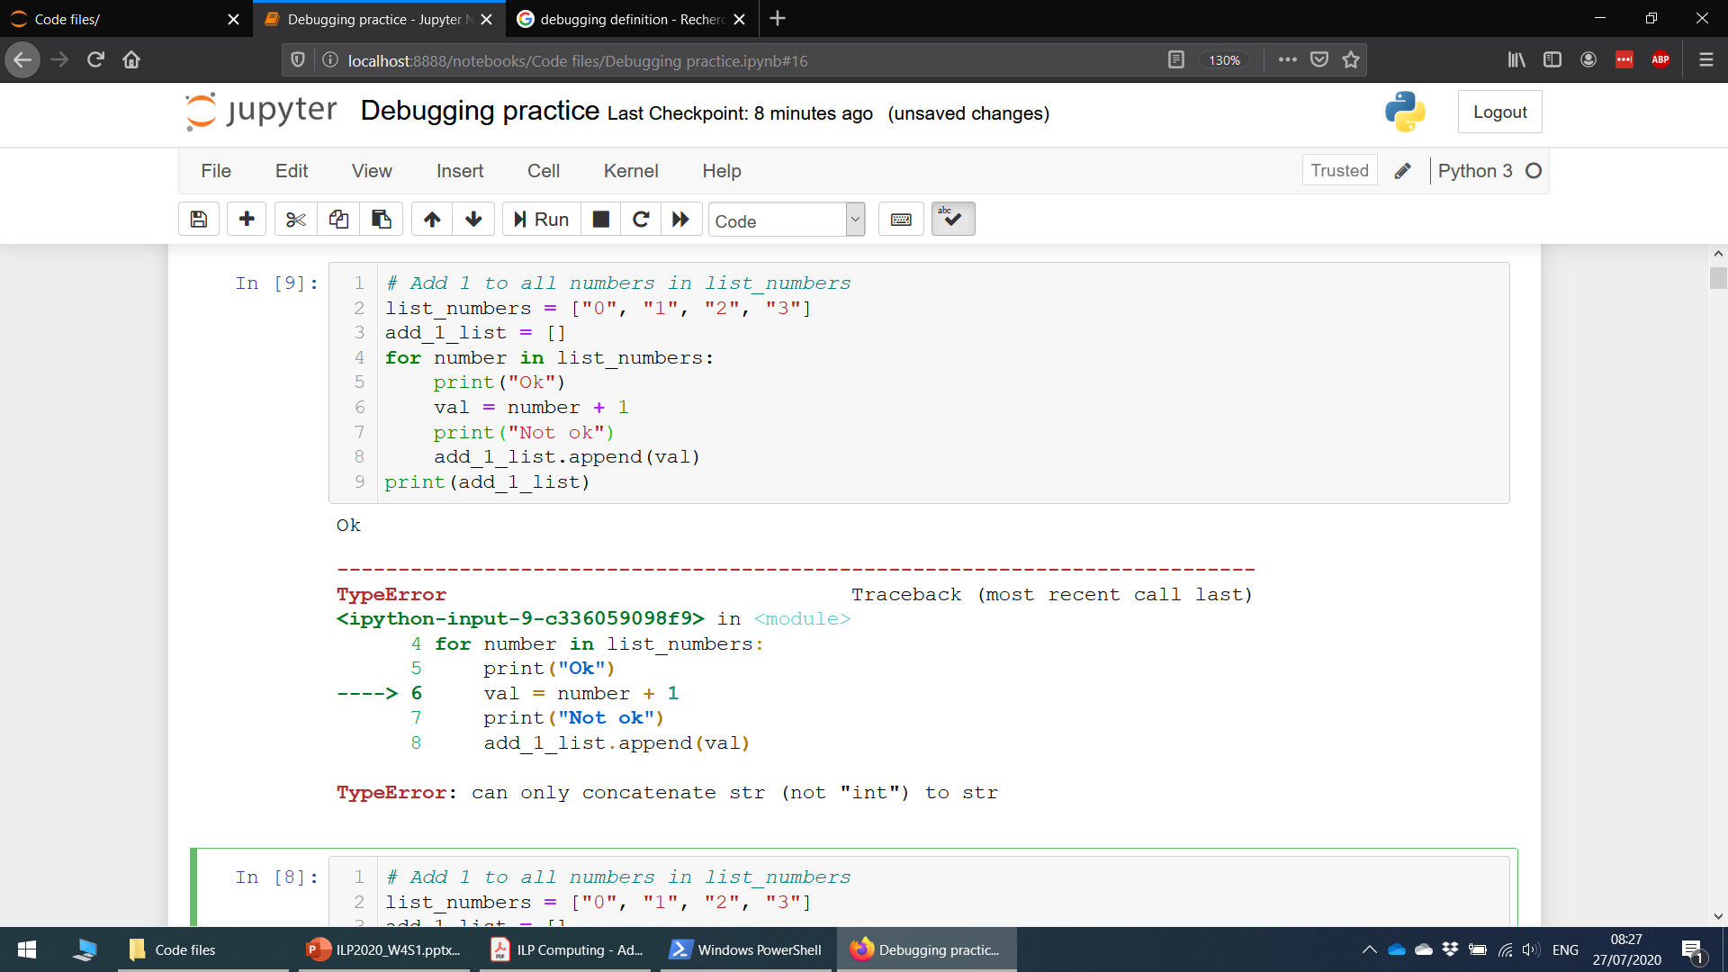
Debugging: 1&2. isolating a problem

Slide 39
Debugging: 3. Fixing the problem
The error message indicates that Python was not able to sum a number (int), with a block of text (string).
Why did this occur?
And how do I fix it?

Slide 40
Debugging: 3. Fixing the problem
Contains strings of digits, not number type!

Slide 41
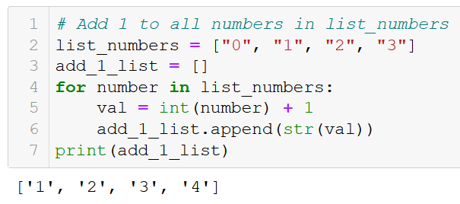
Debugging: 3. Fixing the problem
Proposed fix (one of many): convert to int/float before summing, convert back to str at the end.

Slide 42

Let us practice some debugging!
Open the “Debugging practice” notebook for some typical examples of bugs and debugging!

Slide 43
Conclusion (Chapter 11)
What is testing in programming?
What is a unit test?
What is the assert keyword? How is it related to error messages?
What is therefore the right philosophy for programming and testing?
What is an integration test?
What is debugging?
What are good practices in debugging?

